Slide 1
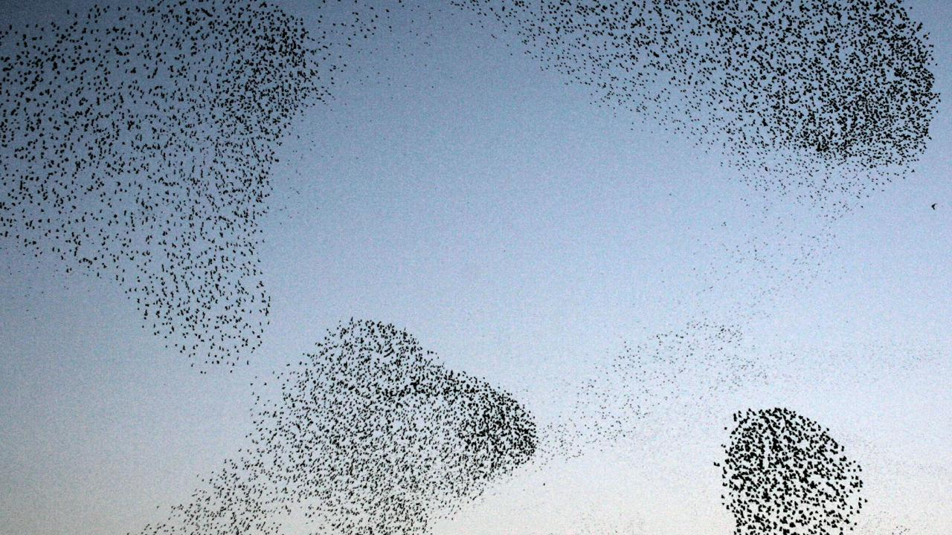
Particle swarm optimization - Converging islands model
Submitted by : Orr Shushan Levi
Instructed and supervised by : Dr. Ofer Shir

Slide 2

Main Goal:
Implementing and testing a new optimization algorithm.
The algorithm is based on the behavior of birds’ flocking.
Comparing results with existing optimization algorithms.
But wait...

Slide 3
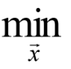
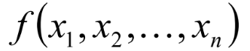
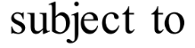
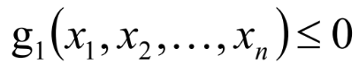
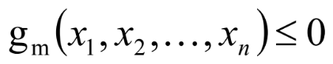
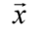
What is an optimization problem?
f is called the objective function or fitness function.
xi are the decision variables.
is a feasible search-point that satisfies all of the constraints g1...gm.

Slide 4

Optimization: The Brute Force Solution
Given a fitness function we can randomly select a candidate solution ( is a search-point that satisfies all of the constraints g1...gm) and evaluate f( ) to get its fitness.
Repeat the process until evaluating the entire solution space, then compare the best score received
that got the best score is the candidate solution that brought f to its minimum, and is called its global minimizer.

Slide 5
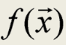
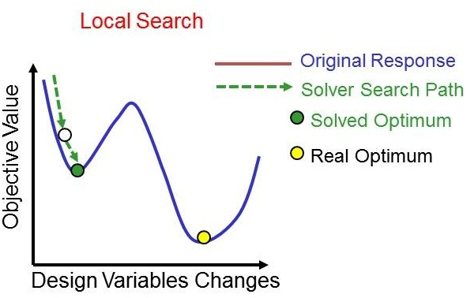
Problems That Arise From The Brute Force Approach
Candidate solution space can be infinite or too large.
Evaluating may take a long time.
f may have several global optima (a multi-modal optimization problem)
f may have local minima (“traps”) so optimization methods such as a hill-climber or Gradient Descent would not locate (in most cases) the global optimizer.

Slide 6
Heuristics for solving optimization problems
Heuristics are educated guesses one implements as an optimization method, based on available knowledge on the fitness function.
Example: minimize cos(x):
Heuristic solution: use only odd numbers constructing a solution X=1*pi, 3*pi …… odd number *pi.
Meta-heuristic solution: choose a number X randomly and calculate cos(X).

Slide 7
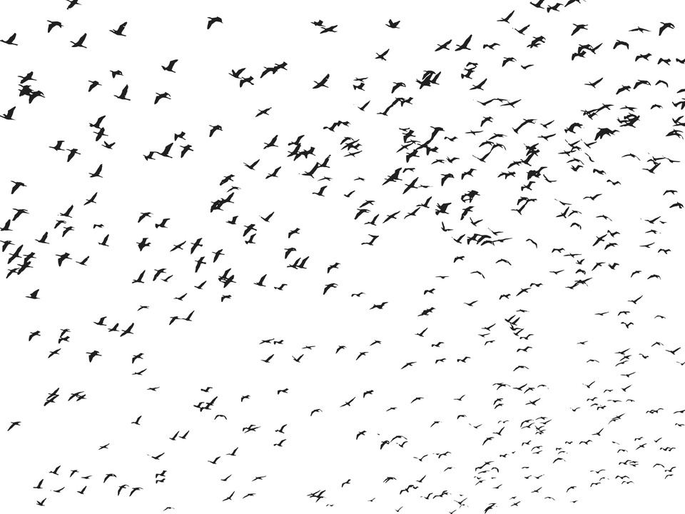
Particle swarm optimization
PSO developed by Kennedy and Eberhart in 1995.
PSO consists of a swarm of particles. Each particle resides at a position in the search space.
The fitness of each particle represents the quality of its position (candidate solution).
Particles travel throughout the search space with a certain velocity. The velocity (both direction and speed) of each particle is influenced by its own best position found so far and the best solution that was found so far by its neighbors.
By the course of time the swarm will converge to optimal positions.

Slide 8
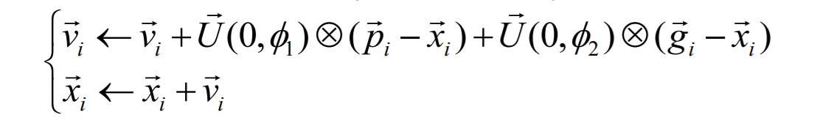
Particle swarm optimization Pseudo algorithm
The classic PSO Algorithm:
Randomly initialize particles positions and velocities
While stopping criterion is not met do:
For each particle i:
Evaluate fitness fi at current position Xi
If fi is better than Pbest-i then update Pbest-i and Pbest-i position marked as Pi
If fi is better than Gbest-i then update Gbest-i and Gbest-i position marked as Gi
For each particle
- Update velocity Vi and position Xi using:

Slide 9
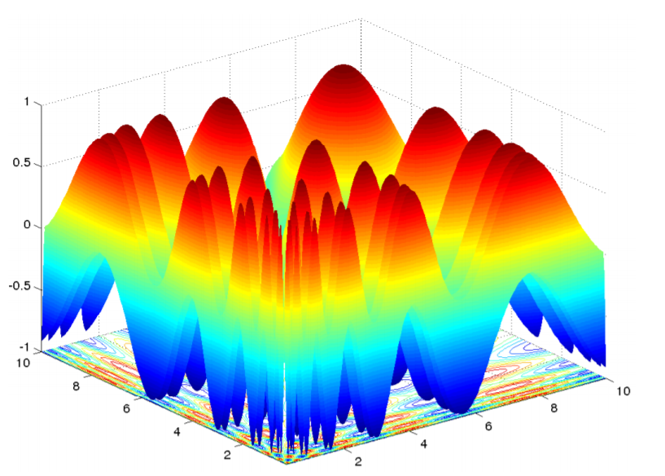
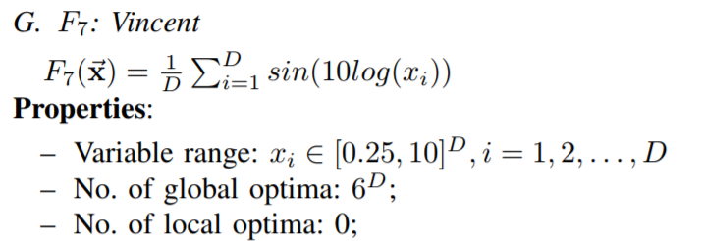
Multi-Modal test function :Vincent

Slide 10

Standard PSO In action:
Source : My program :)
Objective function : Vincent
Dimension : 3
Global minima value : -1
Number of particles: 300
Number of iterations : 9000
Boundary condition : Billiard
Global minima hits : none
Average particle score : -261

Slide 11
Islands PSO Model -Pseudo algorithm
Divide particles into K groups where each group behaves as an independent swarm.
For each group Ki: randomly initialize particles positions and velocities
While stopping criterion is not met do:
For each group Ki :
Evaluate each particle in swarm Ki.
Update swarm Gbest, particles Pbest and velocities.

Slide 12
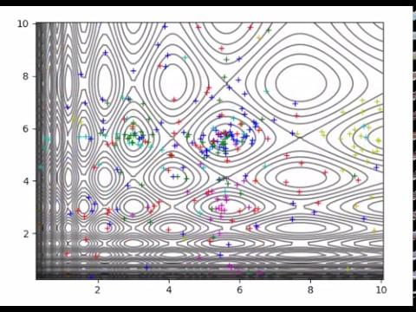
Islands PSO In action:
Source : My program :)
Fitness function : Vincent
Dimension : 3
Global minima value : -1
Number of islands: 10
Number of particles in each island: 30
Number of iterations : 9000
Boundary condition : Billiard
Global minima hits : none
Average particle score : -271

Slide 13

Introducing:
PSO - Converging Islands Model

Slide 14
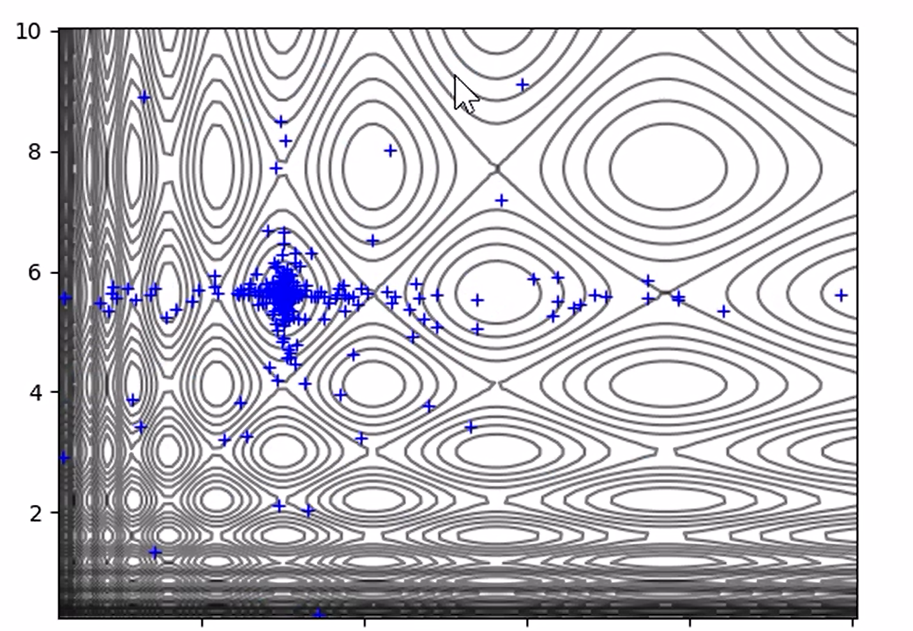
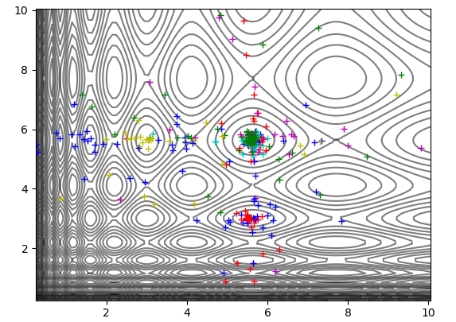
PSO - Converging Islands Model
Motivation:
Standard PSO can be good for local search which focuses on one section of the search space.
Island PSO can achieve global search thanks to the separation of the flocks.

Slide 15

PSO - Converging Islands Model
Motivation continued :
Converging Island PSO tries to achieve both global and local search at the same time.
Based on the following assumption :
Start with Island PSO model.
When reaching a certain amount of iterations, unify the Island having the lowest G-best score with the Island having the highest G-best score, into a single Island.
Particles from the low scored islands will migrate to the high score island and therefore will better utilize iterations to explore the “Hot Spot” found.
Repeat the process until all islands converge into one big flock.

Slide 16
PSO - Converging Islands Model
Pseudo algorithm:
Divide particles into K groups where each group behaves as an independent swarm.
For each group Ki: divide function terrain so particles are initialized within their boundaries.
While stopping criterion is not met do:
For each group Ki :
Evaluate each particle in swarm Ki.
Update swarm Gbest, particles Pbest and velocities.
- If unification criterion met:
- unify (Ki,Kj) -
Where Ki is the Island whose G-best value is the highest among all islands.
And Kj is the Island whose G-best value is the lowest among all islands.

Slide 17
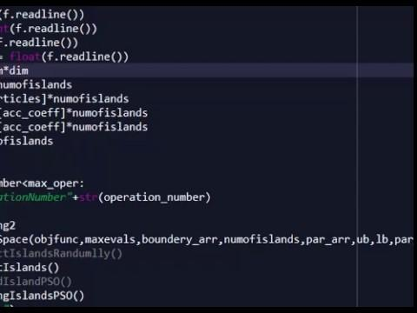
PSO - Converging Islands Model
Illustration :

Slide 18

Facing difficulties
In the previous illustration we observed a division of the main diagonal.
In order to achieve better local search before unification process, we have to find a way to divide n-dimensional space into k equal terrains.
The problem remains open.
Finding the best configuration of heuristic parameters such as:
Number of islands, unification parameter, acceleration coefficient and much more.
In high dimensions it is hard to determine if a global minimum is unique.

Slide 19
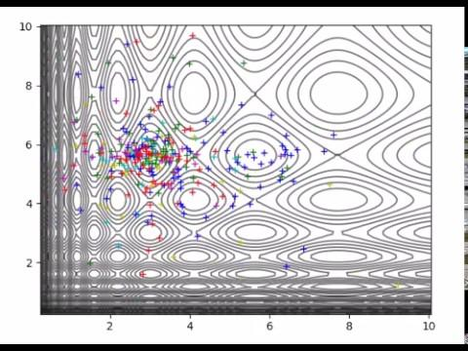
Converging Islands Pso in action:
Source : My program :)
Fitness function : Vincent
Dimension : 3
Global minima value : -1
Number of islands: 10
Number of particles in each island: 30
Number of iterations : 9000
Boundary condition : Billiard
Global minima hits : 2
Iteration took to hit first minima: 7240
Average particle score : -287

Slide 20
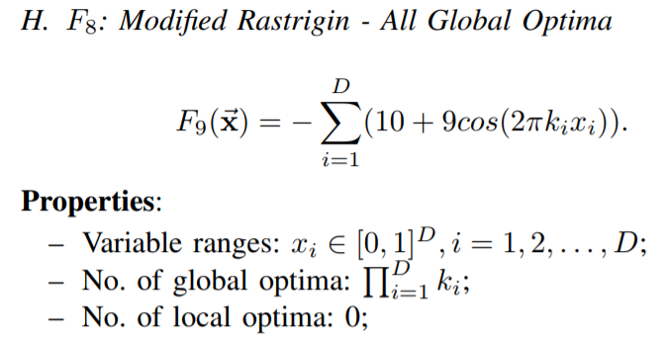
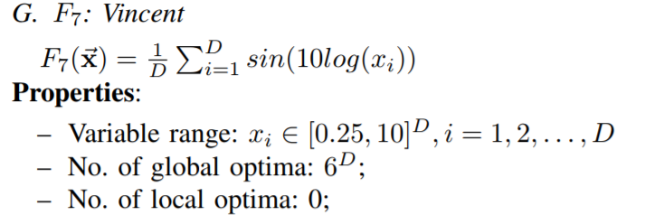
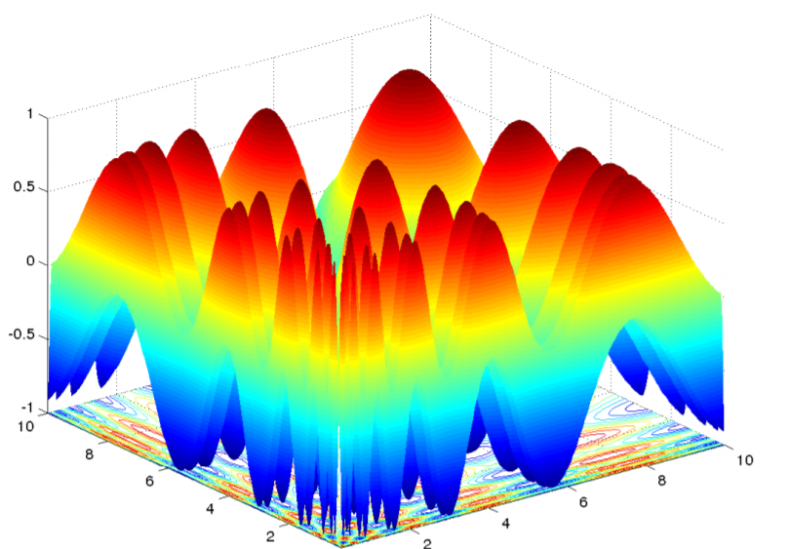
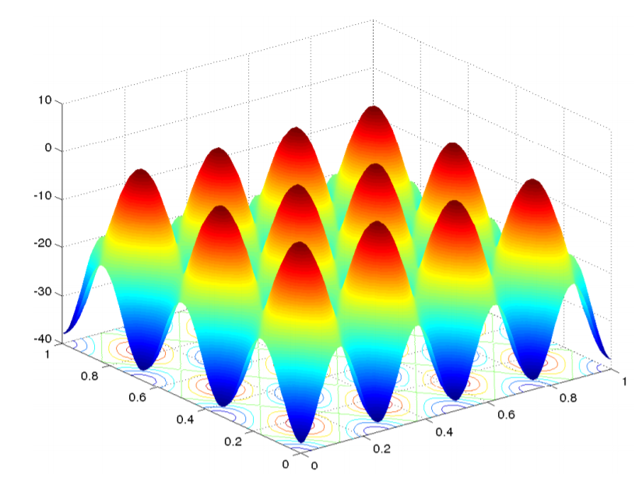
Investigated Benchmark Functions:

Slide 21


Program implementation
My program is implemented in Python.
I used GitHub version control software.
My program implements MVC paradigm.
All of the examples and illustration in this presentation are derived directly from my software.
https://github.com/OrrShushanLevi/ParticalSwarmUnifiedIsland

Slide 22

Conclusions:
The algorithm’s implementation behaves as expected.
In some cases the algorithm shows promising results.
What we achieved so far is a proof of concept!
More observations are required to determine its efficiency.

Slide 23
Acknowledgments:
Dr. Ofer Shir: Guiding & assisting through the whole project.
Mr. Hagai Barmatz : Mathematical assistance.
Mr. Tal Abziz : Initial Software Architecture assistance.

